Slide 1


إتقان ChatGPT: دليل المستخدم لصياغة الأوامر Mastering ChatGPT: Effective Prompting Techniques
المقدم: عبدالرحمن القعاري

Slide 2
Scope
Introduction.
Understanding Prompting in ChatGPT.
Effective Prompting Techniques.
Practical Applications.
GPTs.
Conclusion and Key Takeaways.
Q/A.
مقدمة.
فهم طريقة الأوامر مع ChatGPT.
طُرُق تنفيذ الأوامر الفعّالة.
تطبيقات عملية.
GPTs.
الخلاصة والنقاط الرئيسية.
أ / ج.

Slide 3
Introduction
Overview of ChatGPT: What it is and how it works.
Brief history and development of ChatGPT and its underlying technology.
The significance of AI and language models in today's world

Slide 4
Understanding Prompting in ChatGPT.
Definition of prompts and their role in interacting with ChatGPT.
https://huggingface.co/meta-llama/Llama-2-70b
Types of prompts:
Open-Ended (Creative) Prompts. Example: Tell me a story about a space adventure. Example: Create a short story about a talking tree.
Closed-Ended Prompts. Example: Is Paris the capital of France?
Contextual Prompts. Example: Based on our last discussion, what book would you recommend next?
Instructional Prompts. Example: "Write a poem about spring in the style of a haiku."
Exploratory Prompts. Example: Explain how solar panels generate electricity.

Slide 5
Effective Prompting Techniques.
Be Clear and Specific.
Provide Context.
Use Relevant Keywords.
Use Exemplars When Necessary.
Iterative Approach.

Slide 6
Effective Prompting Techniques.
Task
Context
Exemplars
Persona
Format
Tone
المهمة
السياق
أمثلة
الشخصية
الصيغة
النبرة

Slide 7
Effective Prompting Techniques.
المهمة: يجب أن تعبر جملة المهمة عن الهدف النهائي وتبدأ بفعل يدل على الحدث.
السياق: استخدم ثلاثة أسئلة إرشادية لمساعدتك في ترتيب السياق ذي الصلة والكافي.
النموذج أو المثال: يمكن للأمثلة أن تحسن بشكل كبير جودة الناتج عن طريق إعطاء أمثلة محددة للذكاء الاصطناعي كمرجع.
الشخصية: فكر في من تود أن يكون الذكاء الاصطناعي في الموقف المحدد للمهمة.
الصيغة: تخيل النتيجة النهائية المرغوبة سيعلمك بأي تنسيق يجب استخدامه في إعطاء التوجيهات.
النبرة: يمكنك استخدام ChatGPT لتوليد قائمة بكلمات رئيسية تتعلق بالنبرة لتستخدمها!

Slide 8

Effective Prompting Techniques.
المهمة
السياق
أمثلة
الشخصية
الصيغة
النبرة
أساسي
مهم
مهم
يفضل
يفضل
يفضل

Slide 9

Effective Prompting Techniques. (Task)
I’m 30 years old, Give me a plan to get rich.
Task verbs can be used:
Build, Develop, Give, Write, Analyze, Compare, Describe, Explain, Code, Optimize, Summarize, …., etc.
You can use question to make tasks.

Slide 10
Effective Prompting Techniques. (Task)
You can ask for one task or multiple tasks.
provide a comprehensive analysis of the impact of technology on society by addressing the following three aspects: examine the economic effects of automation and artificial intelligence on global job markets. Discuss the ethical implications of data privacy and surveillance in the context of digital technology, drawing parallels with George Orwell's '1984'. Explore the environmental consequences of technological advancements, particularly in relation to climate change and energy production.

Slide 11
Effective Prompting Techniques. (Context)
Background
Goal
Environment - situation
I’m a programmer, looking to be a Data scientist over the next 5 months. I have free 4 hours 5 times a week, Give me a 5-month program to achieve this goal.
The goal is to reduce the endless possibilities

Slide 12
Effective Prompting Techniques. (Exemplar)
Researches have shown Exemplars that including examples in the prompt improves the quality of the output.
provide me with a python code for creating webserver using flask.
every line of code should have its own detailed comment to explain clearly what is the code.

Slide 13
Effective Prompting Techniques. (Exemplar)
Based on my own resume, help me structure an answer to the interview question: What is your biggest weakness?
Use the star answer framework: Situation, Task, Action and Result.
Here is my Resume:

Slide 14
Effective Prompting Techniques. (Persona)
IF YOU’RE A PROGRAMMER
Senior Software Engineer
IF YOU ARE SICK/INJURED
You are an experienced physical therapist with over 35 years of experience.
IF YOU ARE WORKING ON MARKETING/REPORTS … ETC
You are a senior product marketing manager responsible for …..

Slide 15
Effective Prompting Techniques. (Persona)
You can use similar phrases like:
Act like Elon Musk.
Behave like Spiderman. Act like a children teacher who loves animals.

Slide 16
Effective Prompting Techniques. (Persona)
I’m organizing a weekend retreat for our department of 15 members. The theme is 'Mystery and Intrigue,' and we'll be taking on the roles of famous detectives from literature.
Draft an invitation email as if you were Sherlock Holmes. The retreat will span over 3 days and will include a mix of mystery-solving games, brainstorming sessions, and relaxing activities.
Compose an email for a software engineering student addressing their professor. The student missed an exam due to illness.

Slide 17
Effective Prompting Techniques. (Format)
Tables.
Emails.
Bullet Points.
Code Blocks.
Paragraphs.
Markdown.
Files

Slide 18
Effective Prompting Techniques. (Format)
Based on my own resume, help me structure an answer to the interview question: What is your biggest weakness?
Use the star answer framework: Situation, Task, Action and Result.
Output it in a table format with column headers: Frame, Answer
Here is my Resume:

Slide 19
Effective Prompting Techniques. (Format)
Provide me with an Arduino code that runs 5 LEDS in a harmony way every 300ms. The leds are from 8 until 12 respectively
Every code line should have a comment.
Output it with Arduino code file. Put the file inside a folder with the same name so Arduino can open the file.
optimize this paragraph and bold the changes
Read the tweets. Sentiment Analyze every tweet into ['Positive', 'Negative', 'Neutral']. Output it in table format Tweet | Sentiment

Slide 20
Effective Prompting Techniques. (TONE)
Formal
Informal
Professional
Clear
Show enthusiasm
Sound Pessimistic
Compose an email for a software engineering student addressing their professor. The student missed an exam due to illness and needs to apologize and request a rescheduling of the exam.
The Email should sound Pessimistic.

Slide 21
Effective Prompting Techniques.
Techniques for complex interactions (e.g., continuing conversations, changing topics).
Creative uses of prompts (storytelling, problem-solving, etc.).
Limitations and challenges in prompting and how to overcome them.

Slide 22
GPTs
https://gptstore.ai/
https://gptsdex.com/

Slide 23

Conclusion and Key Takeaways
Summary of the main points covered in the presentation.
Final thoughts on the impact and future of ChatGPT and AI prompting.
Encourage ongoing learning and experimentation with ChatGPT.

Slide 24
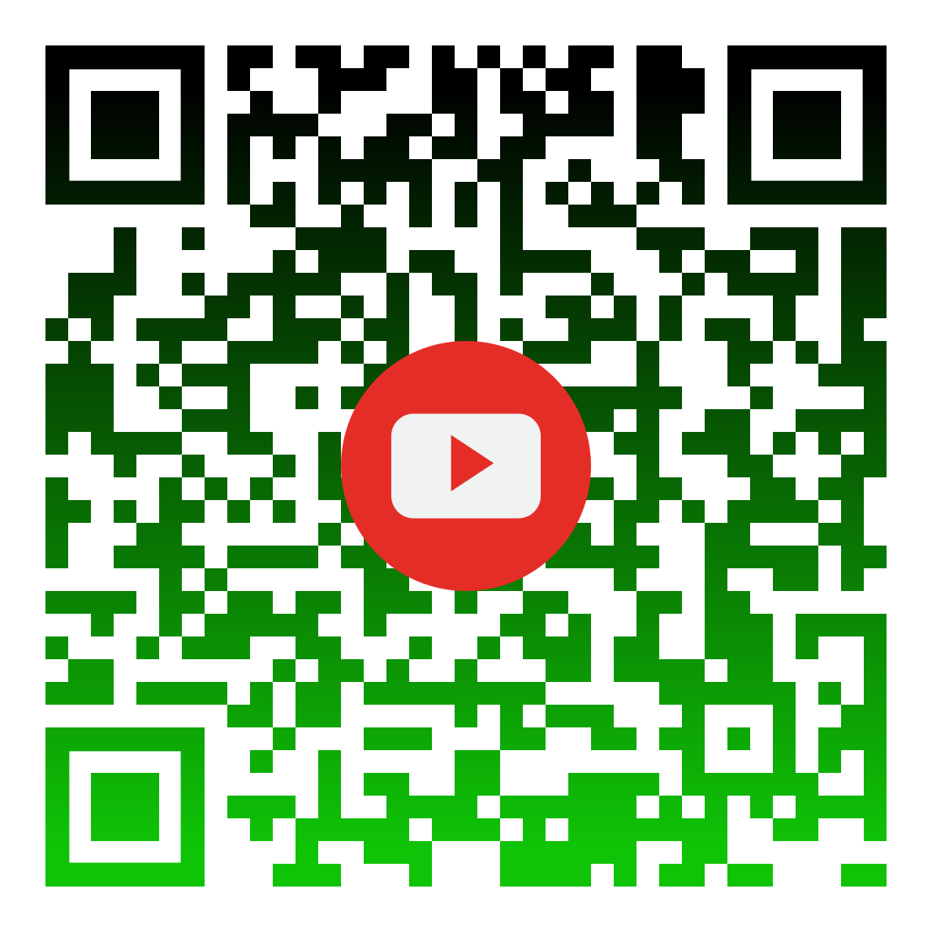
Q/A

